Slide 1
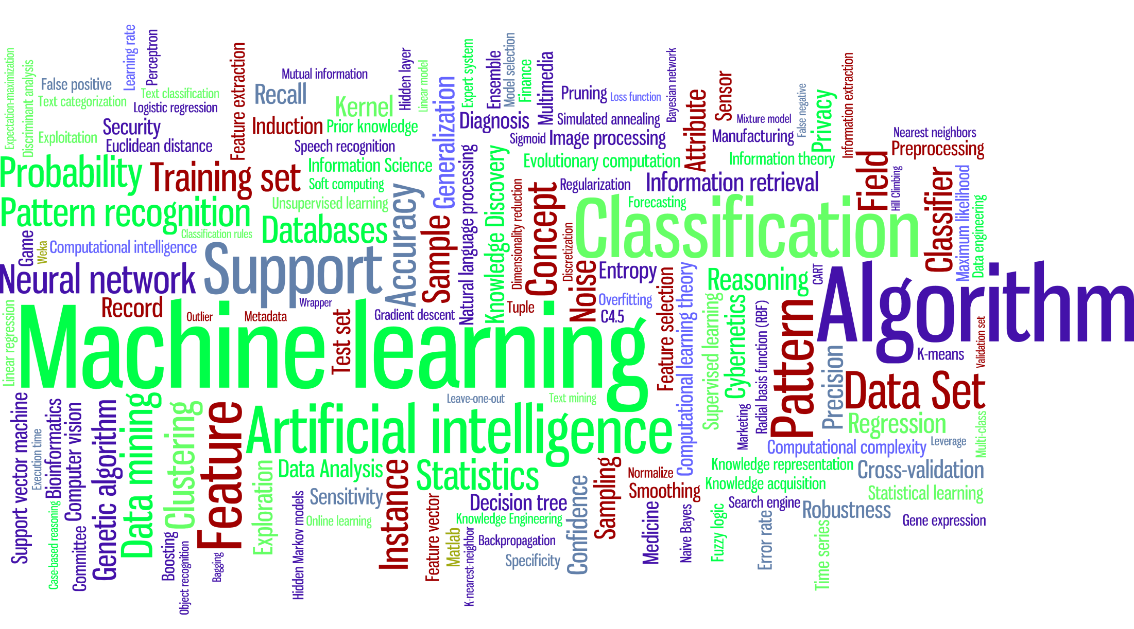
Introduction to Machine Learning

Slide 2
Speaker - Uday Upreti
udayupreti.me
uday1201@acm.org

Slide 3
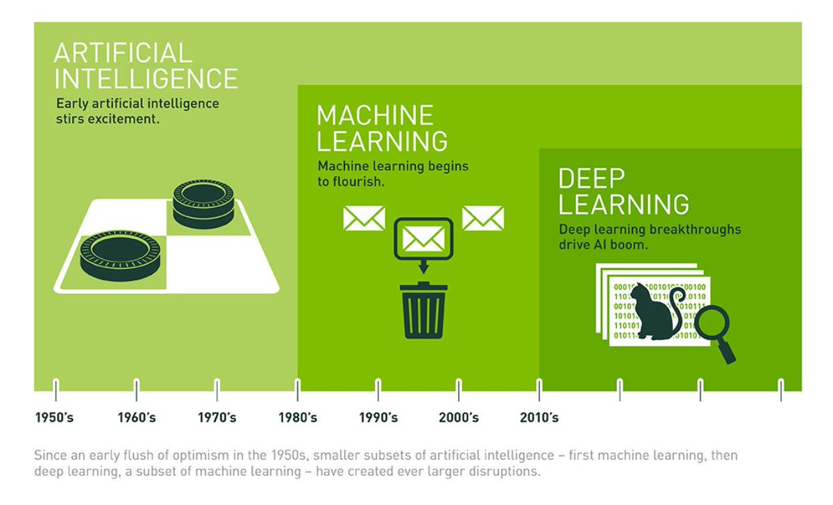

Slide 4
Artificial Intelligence
Computer scientists have defined artificial intelligence in many different ways, but at its core, AI involves machines that think the way humans think. Of course, it's very difficult to determine whether or not a machine is "thinking," so on a practical level, creating artificial intelligence involves creating a computer system that is good at doing the kinds of things humans are good at.

Slide 5
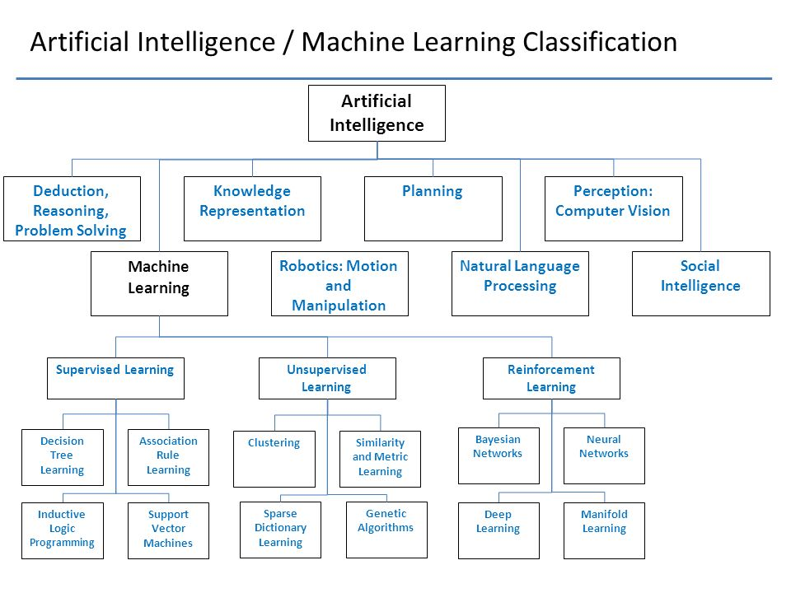

Slide 6


Slide 7


Slide 8
Machine Learning
The phrase "machine learning" also dates back to the middle of the last century. In 1959, Arthur Samuel defined machine learning as "the ability to learn without being explicitly programmed." And he went on to create a computer checkers application that was one of the first programs that could learn from its own mistakes and improve its performance over time.

Slide 9
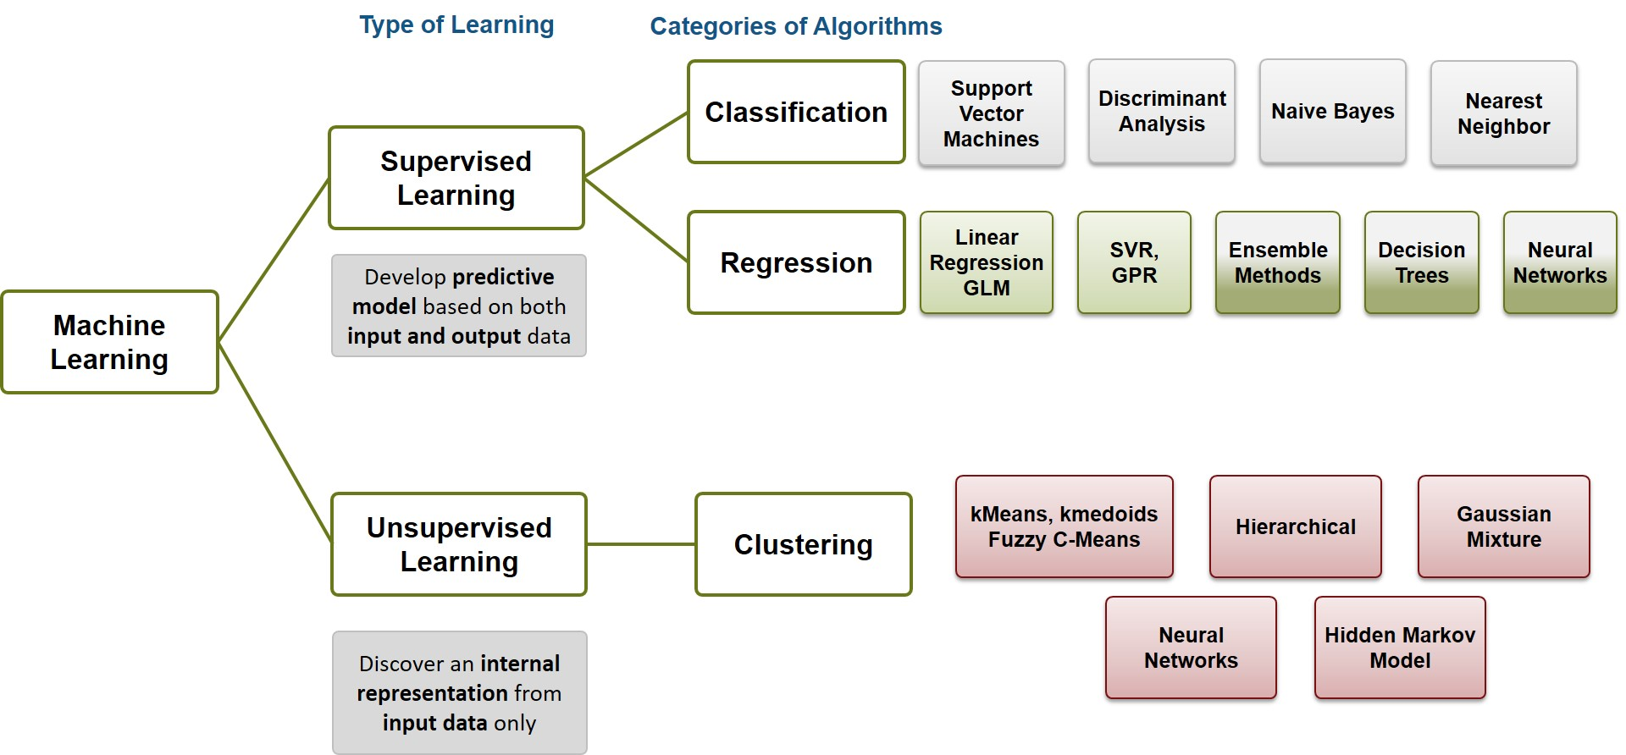

Slide 10
Types of data
Labelled data
Labelled data typically consists of a bag of multidimensional feature vectors (normally called X) and for each vector a label, Y which is often just an integer corresponding to a category eg. (face=1, non-face=-1)
Unlabelled data
Unlabelled data misses the Y component. There are many scenarios where unlabelled data is plentiful and easily obtained but labelled data often requires a human/expert to annotate.

Slide 11
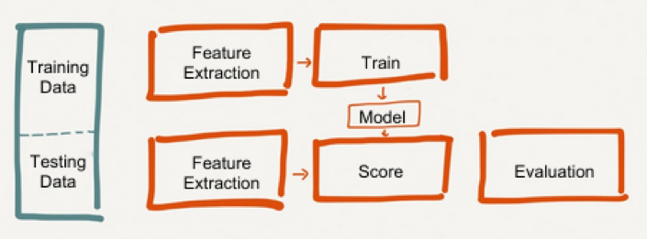
How data is used in ML algorithms

Slide 12

Supervised Learning
In supervised learning, we are given a data set and already know what our correct output should look like, having the idea that there is a relationship between the input and the output.
Supervised learning problems are categorized into "regression" and "classification" problems. In a regression problem, we are trying to predict results within a continuous output, meaning that we are trying to map input variables to some continuous function. In a classification problem, we are instead trying to predict results in a discrete output. In other words, we are trying to map input variables into discrete categories.

Slide 13
Linear Regression

Slide 14
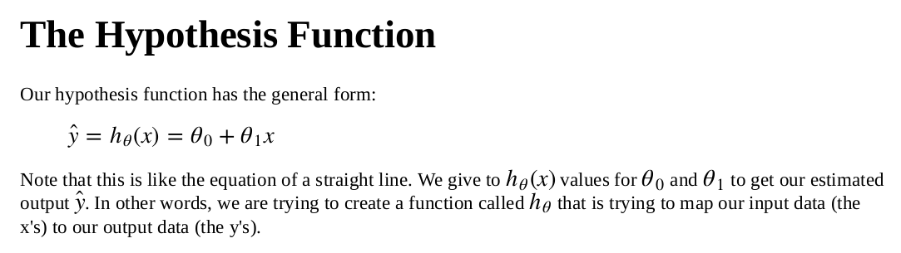

Slide 15
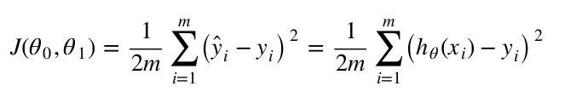
The Cost function (evaluating error)

Slide 16
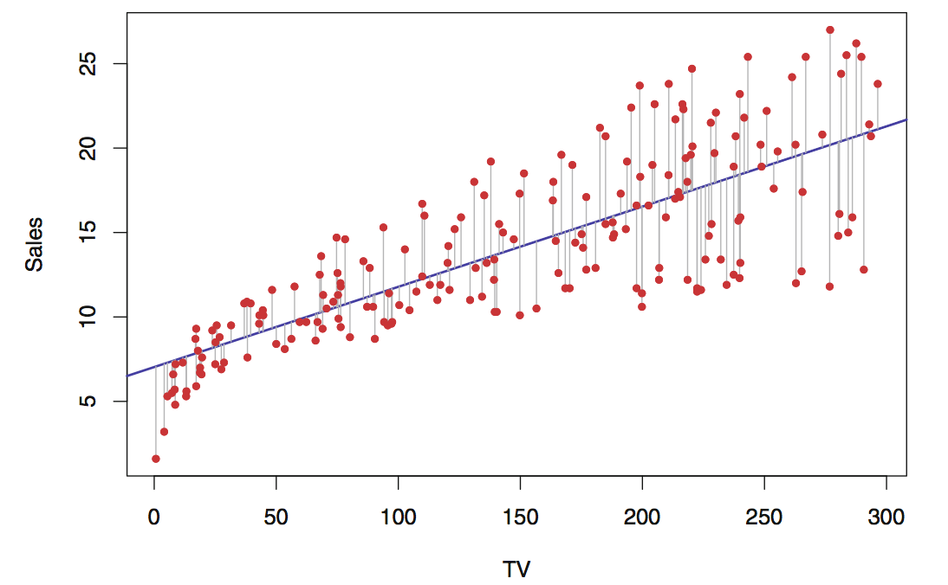

Slide 17
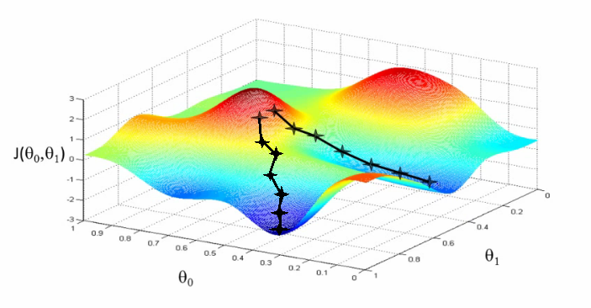

Slide 18
Logistic Regression
Now we are switching from regression problems to classification problems.
Binary Classification
Instead of our output vector y being a continuous range of values, it will be 0 or 1.
y∈{0,1}
We're only doing two classes for now, called a "Binary Classification Problem."

Slide 19
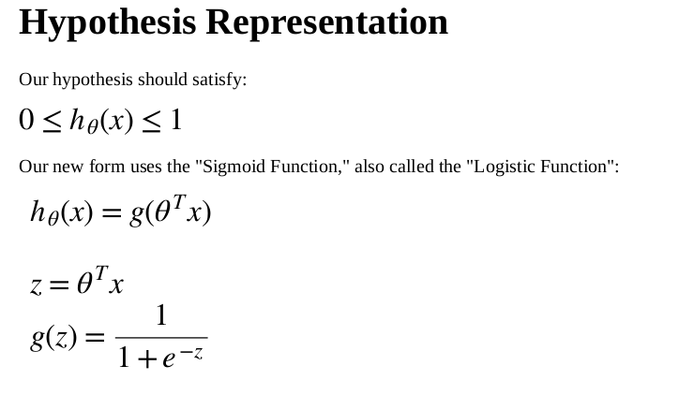

Slide 20
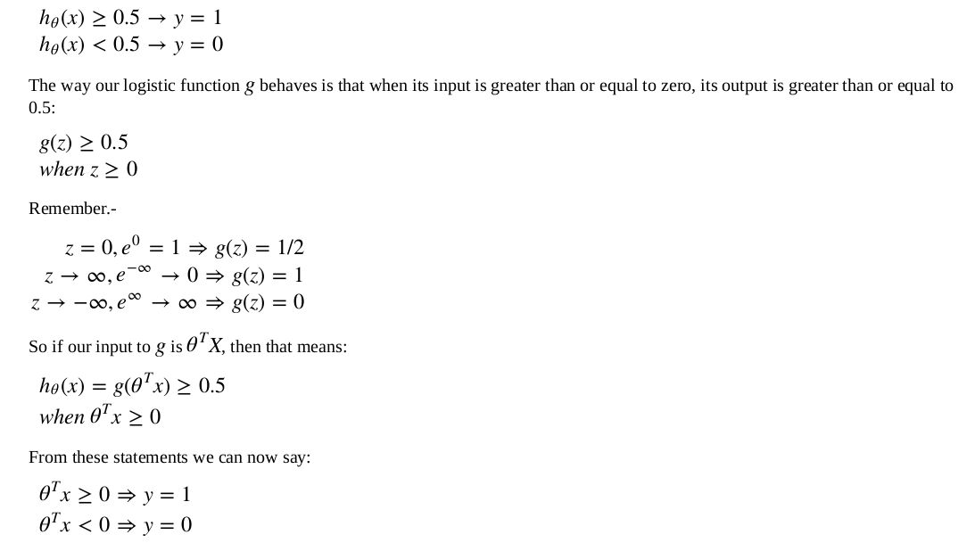
Decision boundary

Slide 21
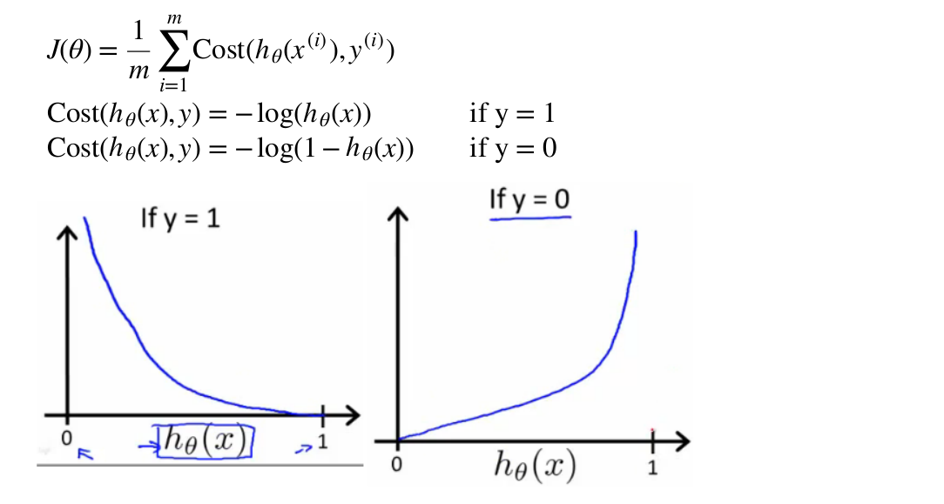

Slide 22
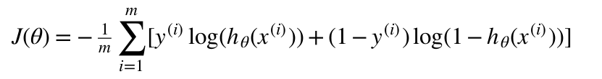

Slide 23
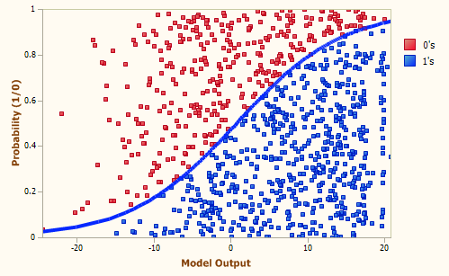

Slide 24
Unsupervised Learning
Unsupervised learning, on the other hand, allows us to approach problems with little or no idea what our results should look like. We can derive structure from data where we don't necessarily know the effect of the variables.
We can derive this structure by clustering the data based on relationships among the variables in the data.
With unsupervised learning there is no feedback based on the prediction results, i.e., there is no teacher to correct you.

Slide 25
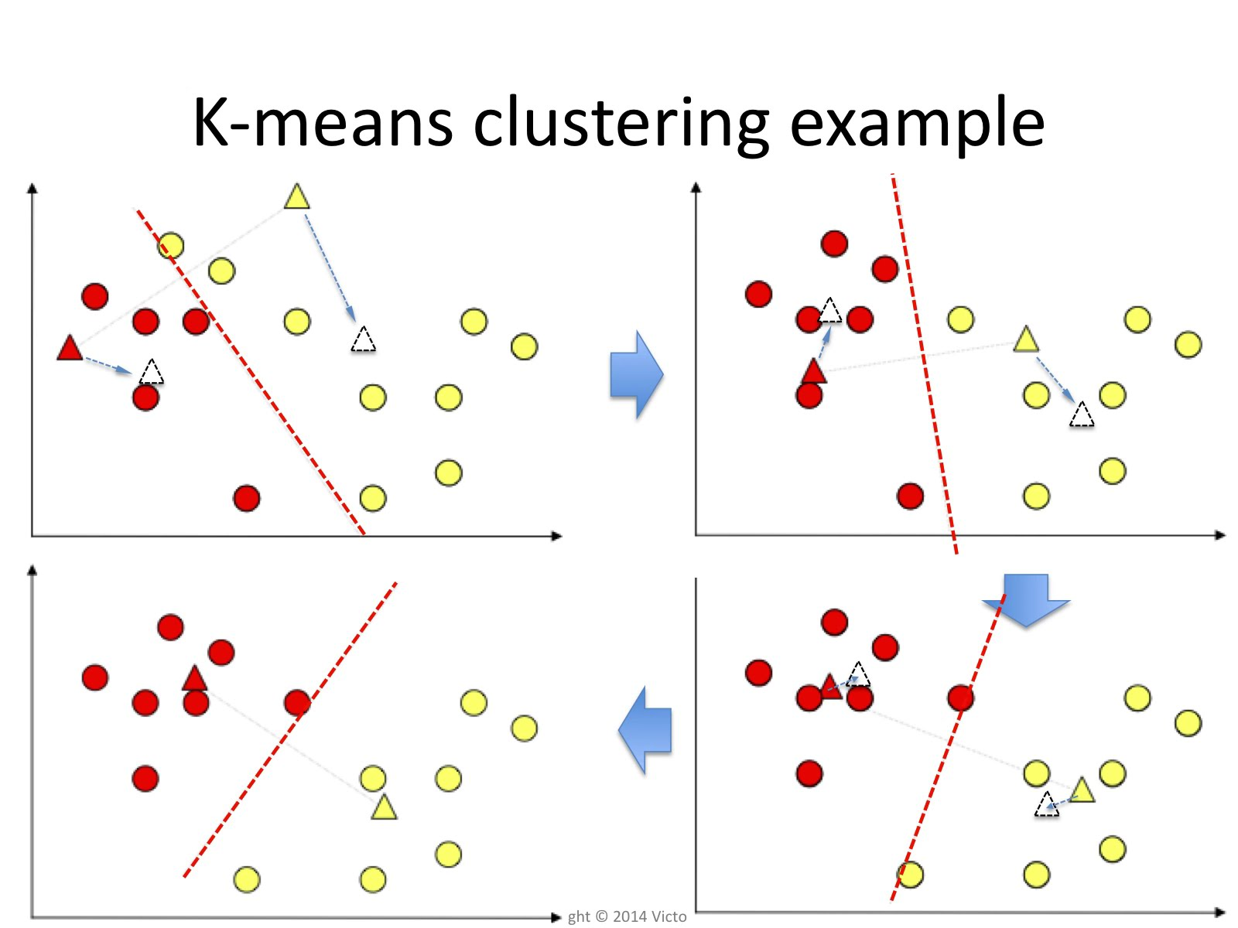

Slide 26
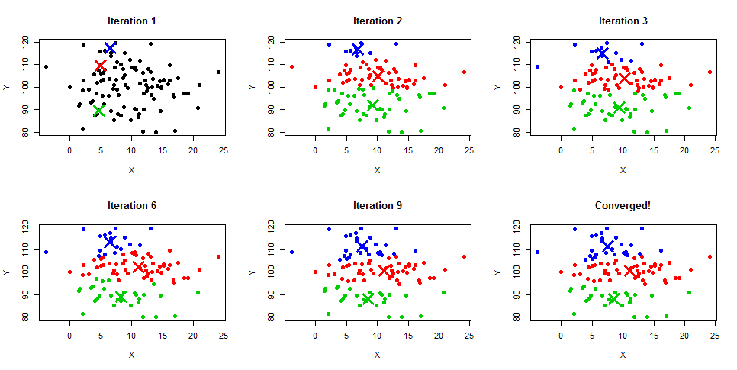

Slide 27


Slide 28
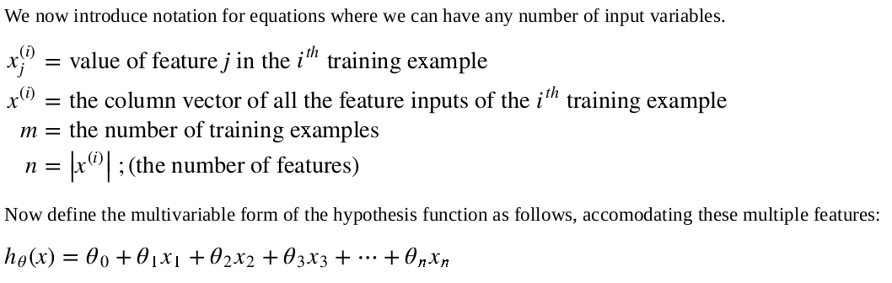

Slide 29
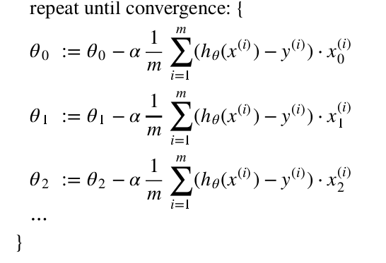
Gradient Descent

